Slide 1

Smart Cookies & Digital Cookie
2025 Troop Cookie Manager Training
Notes:
Welcome back to the 2025 online Troop Cookie Manager Training for Girl Scouts River Valleys

Slide 2
Online Training Series
Five Training Videos
Cookie Program Overview
Engaging Troops and Girls
Managing the Cookies
Managing the Cookie Finances
Smart Cookies & Digital Cookie
Notes:
This is the fifth and final video in a series of your five training videos. This session is packed with information on Smart Cookies and Digital Cookie, the online systems you and your Girl Scouts and families will use to manage sales and engage in online sales and mobile payments.

Slide 3
Section Topics
Smart Cookies & Digital Cookie
Online Cookie Systems Updates
Smart Cookies
Updates for 2025
Volunteer Access
Smart Cookies Sales Management
Resources
Digital Cookie
Volunteer Access
Mobile App Enhancements
Resources
Notes:
The section topics that we will review today include:
Online Cookie Systems Updates
Smart Cookies
Updates for 2025
Volunteer Access
Smart Cookies Sales Management
Resources
Digital Cookie
Volunteer Access
Mobile App Enhancements
Resources

Slide 4

What is Smart Cookies?
Smart Cookies is the platform used for Troop cookie sales management.
  Entering your initial order
  Transferring/reviewing cookie inventory
  Scheduling cookie booths & allocating booth sales
  Crediting Girl Scouts with cash/check payments
  Running reports
  Entering rewards choices
Notes:
If you’re a new Trop Cookie Volunteer, you may be wondering what is Smart Cookies? Smart Cookies is the online cookie system that troop volunteers use to:
1. Place an initial cookie order
2. Transfer and reviewing cookie inventory
3. Schedule cookie booths & give credit for booth sales
4. Credit girls with cash/check payments
5. Running reports
6. And last but not least, order rewards

Slide 5

What is Digital Cookie?
Digital Cookie is the online cookie system that troop volunteers and their Girl Scout families use to engage in online sales.
Mobile app for processing payments:
  In-person sales
  Cookie Booth sales
Notes:
Now, let’s review what Digital Cookie is and how you will use it. Digital Cookie is the online cookie system that troop volunteers and their Girl Scout families use to:
-sell cookies online-Girl Scouts/Families can download the Digital Cookie Mobile App to their mobile device to use for selling in-person and at cookie booths, with the option to take credit card, PayPal, and Venmo payments from their cookie customers. You will also use the app to take theses payment options at your troop cookie booths. These options are also available when customers order cookies online for shipped only or in-person delivery.

Slide 6
Online Cookie Systems Updates
Notes:
Now that you have an understanding of the two platforms troops and Girl Scouts use to manage their cookie sale, let’s cover the enhancements to these Online Cookie Systems for the upcoming season.

Slide 7

2025 Smart Cookies & Digital Cookie Updates
Improved user access
Faster updates
Expanded payment options in the mobile app
Notes:
After taking in feedback from families, volunteers, and our own council staff, the Digital Cookie team at GSUSA has worked on smoothing out the Girl Scout & Troop experience for 2025.
The updates they’ve made, which we will cover in this section, focus on user access, faster updates, and expanding payment options in the mobile app.

Slide 8
New! Online Cookie Systems Guide
  Find it on Cookie Central
  All instructions and videos for volunteers in one spot
  Features Digital Cookie Connections to callout when/how the systems connect
  Just in time reminders & instructions in The Cookie Press
Notes:
Here at Girl Scouts River Valleys we have also worked hard to revamp our online systems resources for 2025! We’re excited to introduce the new Online Cookie Systems Guide—a one-stop hub on Cookie Central for Smart Cookies and Digital Cookie. This guide includes updated instructions, videos, and a new feature called Digital Cookie Connections, which explains where the two systems align. You’ll find the Digital Cookie Connections in the Smart Cookies information. For example, you can now learn how to use reports to compare Digital Cookie and Smart Cookies data or view Girl Scout Digital Cookie sales directly in Smart Cookies.​
Alongside this guide, we’ll share timely reminders and tips in The Cookie Press. Don’t forget that you can reach out to your Community Product Leader too, who can share their own tips and tricks with you as you take on the cookie season.​

Slide 9
Smart Cookies
Notes:
Now, let’s focus on what’s new with Smart Cookies..

Slide 10
Smart Cookies
Updates to the System
Smart Cookies Data Pull
Volunteer Access Dates
Viewing Payments
Smart Cookies Support
Notes:
Good news! There are no major changes to the volunteer experience in Smart Cookies. The way you place your initial order, select a delivery location, transfer cookies, select booths, use the Smart Booth Divider-you get the idea-it all will work the same this year. In this section we’ll review the major updates to the system, how data from Smart Cookies gets pulled from Digital Cookie, your volunteer access dates, viewing payments in the system, and where you can find Smart Cookies support.

Slide 11

Smart Cookies Updates
Faster Updates Between Systems
Smart Cookies will pull data from
Digital Cookie on a scheduled basis
Troop to girl transfers completed in Smart Cookies will appear quicker on the Digital Cookie dashboard
Notes:
The biggest change for Smart Cookies is the way sales information will transfer to Digital Cookie. Smart Cookies will be pulling data from Digital Cookie on a scheduled basis. This process should assist with updates in the system to be seen in minutes on the Girl Scout’s Digital Cookie dashboard, instead of hours or days.

Slide 12
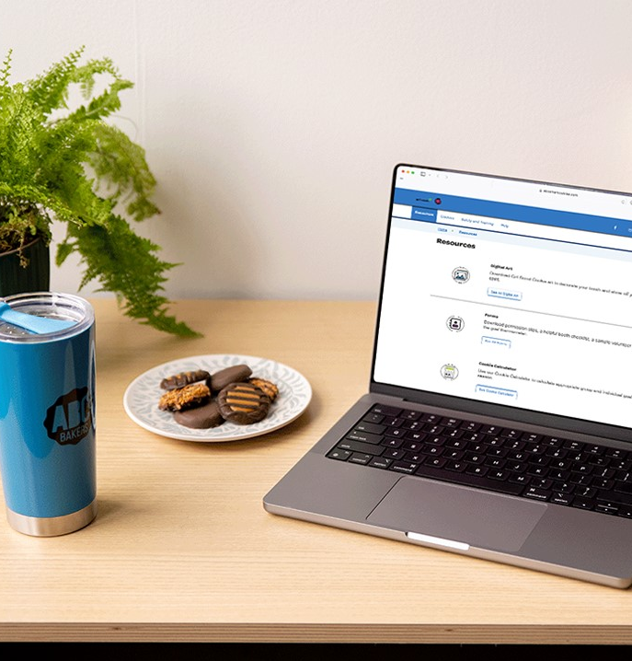
Smart Cookies Updates
New process to send Troop & Girl Scout data from Smart Cookies to Digital Cookie
Action Needed: Before January 9, verify information is accurate in Smart Cookies
Troops ensure all Girl Scout info is correct
Connect with River Valleys Staff to update any information
Notes:
Another enhancement this season is ensuring we have the most up to date information for your troop members in Smart Cookies before we transfer the information into Digital Cookie. The River Valleys Team has added all Troops and Girl Scouts that were registered as of December 1 to Smart Cookies. Before we send that information to Digital Cookie, we need your help to ensure the information is as accurate as possible. ​Here's how you can help:​
We ask that all troop volunteers verify the Girl Scouts within their troop are listed correctly in Smart Cookies, by January 9. If any information is incorrect or missing, reach out to River Valleys to make any changes.​ If everything is accurate, no further action is needed.
River Valleys will continue to add and newly formed troops and newly registered Girl Scouts to Smart Cookies throughout the entire cookie season.

Slide 13
Smart Cookies Volunteer Access
Smart Cookies registration emails
    Week of December 16
Two troop contacts
    Troop Cookie Manager & Troop Leader
Contact GSRV
    Additional Users added, contact before January 9
Add noreply@abcsmartcookies.com to your safe sender list!
Notes:
When will you get access to Smart Cookies for the season? Registration emails will be sent the week of December 16. ​​
Troops will have two contacts added in Smart Cookies: this is the troop cookie manager and troop leader. You can request to provide additional users with access to the system by contacting River Valleys staff. It would be terrific to have these additional troop users added in Smart Cookies before January 9, when they are transferred into Digital Cookie for the season. Don’t worry, if that date is missed, users will still be added into Smart Cookies after January 9th, but they will not be added to Digital Cookie until the next day - after Smart Cookies and Digital Cookie sync overnight.​​
Troop contacts will receive system emails from Smart Cookies and can perform all cookie functions for your troop. Additional Troop users will not receive the system emails but will be able to perform all cookie functions for the troop.
When you have access to the site, you can also enter the number of Girl Scouts selling, enter your initial order, and select your delivery location for Mega Drop deliveries.
It’s important to note that Smart Cookies contact information does not carry over from year to year. So, all volunteers must register their Smart Cookies account each season.
We encourage you to add noreply@abcsmartcookies.com to your safe sender list to ensure you don't miss the registration email.

Slide 14
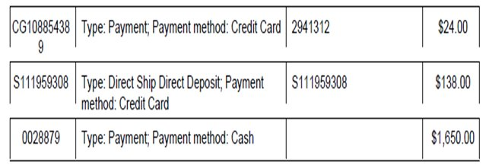
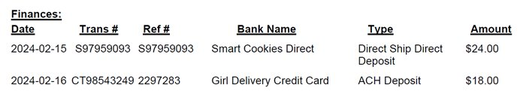
Smart Cookies
Credit card, PayPal, and Venmo payments will be made in Digital Cookie
Troop will be credited for these sales in Smart Cookies
Payments are reflected in Smart Cookies on Girl and Troop Financial Transactions tab or Balance Summary Reports
Smart Cookies Financial Transactions Girl Balance Summary Report
Smart Cookies Financial Transactions Troop Balance Summary
Notes:
After you’ve gained access to the Smart Cookies system, let’s talk about how you’ll review the payments your Girl Scouts accept in Digital Cookie after the sale begins. Digital Cookie is where online & mobile payments are processed, but your troop will be credited for these sales in SC.
When you take booth payments using mobile app for your troop, these payments are reflected in Smart Cookies on Girl and Troop Financial Transactions tab or Balance Summary Reports. We’ll talk about the mobile app payments in Smart Cookies soon.

Slide 15
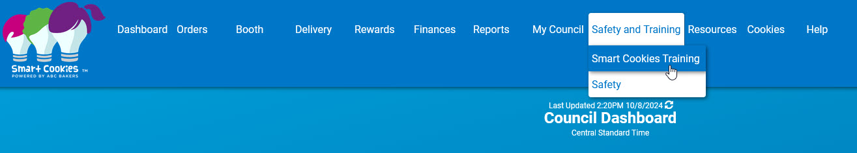
Additional Smart Cookies Support
Girl Scouts River Valleys Staff
Smart Cookies Help Desk for Volunteers:
  ABCSmartCookieTechSupport@hearthsidefoods.com
  855-444-6682
Safety and Training tab in Smart Cookies
Notes:
Finally, if you need any additional Smart cookies support, it’s available for you! River Valleys staff is ready to help troubleshoot issues or provide reassurance when you need it. ABC Bakers offers a Smart Cookies Help Desk exclusively for cookie volunteers. You can reach them by email or by phone, 7 days a week from 8am-11pm CST. And you can access the Safety and Training tab in Smart Cookies with quick links to training videos right in the site. The training videos have been updated for this season too.
Don’t forget that you can also reach out to your Community Product Leader, they have a wealth of information and can share tips and tricks to help you as you navigate Smart Cookies.

Slide 16
Digital Cookie
Notes:
Let’s look at the Digital Cookie updates for this upcoming season!

Slide 17
Digital Cookie
Access Dates
Improved Customer Check-out Experience
Updated Features for Girl Scouts and Troops
New Resource for Tracking Family Inventory Need
Notes:
Here’s an overview of the Digital Cookie updates. We’ll look further at each of these shortly.
-we’ll review the access dates for Volunteers
-take a look at an improved Customer Check-out Experience
-review the updated features for Girl Scouts and Troops
-and introduce a new Resource to help families track their cookie inventory

Slide 18
Digital Cookie Access
Volunteer access to Digital Cookie begins January 24
Girl Scouts and families will receive access to Digital Cookie via a registration email on February 1
Notes:
Volunteers will receive access to DC on Jan. 24 & Girl Scouts & their families will receive access to DC via a registration email on Feb. 1

Slide 19
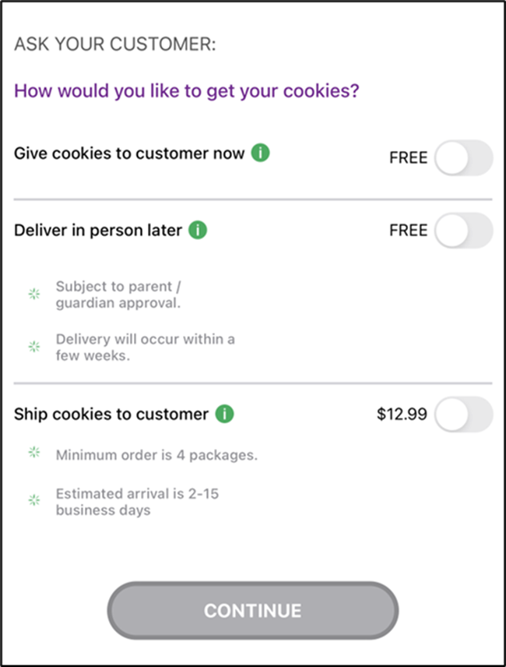
Digital Cookie Mobile App Enhancements
    Improved Customer Check-out Process:
    No longer required to fill in customer name, email, zip for Give Cookies to Customers Now
    Girl Scout login on Mobile App:
    No more differentiation between sold at booth or not sold at booth
    Renamed as Give cookies to customer now
    Update the Mobile App on Devices
Notes:
Now, Let’s look at the Customer Experience in Digital Cookie, specifically the mobile app enhancements that customers (and girl scouts) will notice while they are checking out using the mobile app:
-first, there’s an improved check out process for customers and volunteers, It’s no longer required to fill in the customers name, email, or zip code for “give cookies to customers now” sales. More on what that means in a moment.
-The Girl Scout login on the Mobile App has removed the differentiation between “Sold at booth” and “not sold at booth”. Instead, Girl Scouts when logged into their Girl Scout view will see “give cookies to customers now”. This will help to eliminate confusion when Girl Scouts are selling on their own, using their own inventory. When logged into the troop view of the mobile app, users will still see “sold at booth” vs. “not sold at booth”
- New troops will want to download the Digital Cookie Mobile app on your smart devices, If you’re a returning troop, make sure all troop volunteers and Girl Scout families update the app before Cookie Go Day to ensure you’ll have full access to all these great enhancements

Slide 20
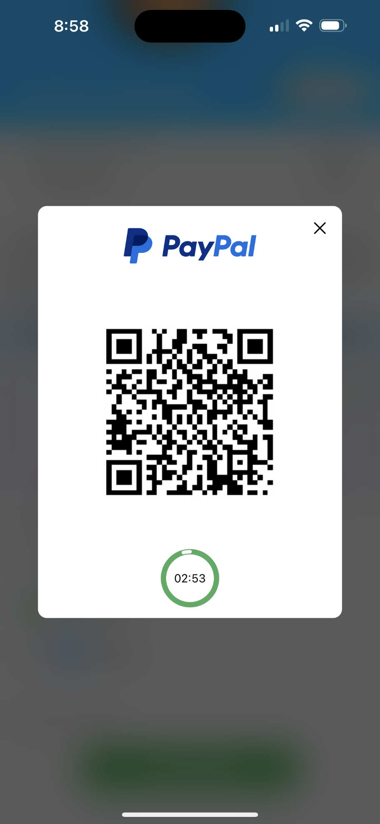
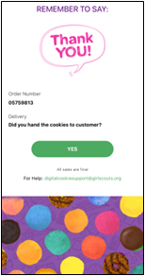
Digital Cookie Mobile App Enhancements
Venmo and PayPal available for Give Cookies to Customer Now
Customers will scan the QR Code with their own cellphone to complete payment
Thank You Confirmation Screen
Venmo/PayPal payments go to River Valleys directly and not a troop or Girl Scout Venmo/PayPal account.
Demo
Notes:
As stated before, Venmo and PayPal are now available payments options for those “give cookies to customers now” purchases on the digital cookie app
When Venmo or PayPal is selected, a QR code will pop up on the screen for customers to scan with their own cellphone and complete payment. Girl Scout/Caregivers do not need to give their cellphone to the customer. Payment is initiated on the Girl Scouts cellphone but is ultimately completed on the customers cellphone. After the payment has fully processed, the Girl Scout/Caregivers mobile device will receive an order confirmation screen and a reminder to thank the customer for their order.
Payments made through Venmo/PayPal go to River Valleys directly and not a troop or Girl Scout Venmo/PayPal account. Troops will see this credited in Smart Cookies. This is the same as a typical credit card payment made in Digital Cookie which comes directly to GSRV, and not into the troop’s bank account.

Slide 21
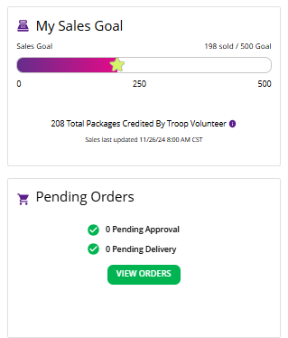
Girl Scout and Troop Experience
Simplified Progress Bar on Dashboard & Progress Bars update more frequently
Pending Orders visibility
Improved web view on phone, tablet, laptop
Notes:
Girl Scouts and Troops will have a more simplified experience as well! Here’s the most important information to know:
The dashboard tab has several updates:
-the progress bar on the dashboard is more simplified & will update more frequently (woohoo!). We recognize that the progress bar can cause some confusion. Troop Volunteers and Girl Scouts can see your Girl Scout’s progress toward her goal and see how many cookies that you (the troop cookie volunteer) have assigned to your Girl Scout.
Donated and In hand orders appear right away.
Shipped orders appear in the graph when the order ships. This can take a few days, orders don’t ship on weekends and holidays.
In-person delivery orders appear when the order is approved
Girl Scouts can add offline sales under the site setup page so customers can see a true representation of her sales.
-and all pending orders will also be more visible on the dashboard
-overall, the digital cookie web view is improved for users no matter their device (Cell Phone, Tablet, Laptop, etc.)

Slide 22
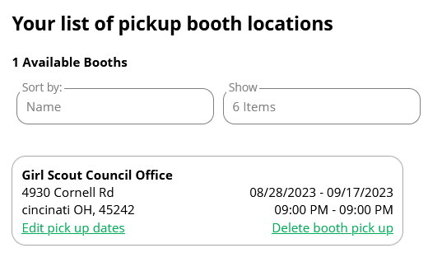
Girl Scout and Troop Experience
My Cookies tab – “Cookie Share” renamed to “Donate Cookies”
Booth Pickup tab – shows booth reservations
Booth Pickup Option for Pre-Paid pickup (rarely used)
  Use the Smart Booth Divider in Smart Cookies to allocate the packages to Girl Scouts for orders made using a booth pickup option
Notes:
The My Cookies tab has changed to better reflect donated cookies. Previously, “Cookie Share”, this language is now renamed “Donate Cookies” for better clarity.
The Booth Pick-up tab shows the existing booth reservations that a troop has secured in Smart Cookies. While used rarely, your troop has the option to add pre-paid pick up for customers at booths using this tab. This pick up option replaces the troop virtual booth link from last year. If you utilize this option, you’ll use the Smart Booth Divider in Smart Cookies to credit packages sold to the Girl Scouts from the booth.

Slide 23

Cookie Donations: Council vs. Troop Inventory
Any donation can go towards Virtual Cookie Share (council inventory)
Donations that ONLY go to Virtual Cookie Share (council inventory):
Donations accepted from a digital cookie shipped-only order
Donations accepted from the troop’s booth pick up link.
Most donations can go towards Tracked Cookie Share (troop inventory)
View Managing Cookie Donations in Smart Cookies tip-sheet
Notes:
Let’s talk about Donations and Digital Cookie (and Smart Cookies). For more details, you can refer to the Online Cookie Systems Guide on Cookie Central or the Managing Cookie Donations in Smart Cookies tip sheet.
A common question we get is how to know if a donation counts towards your troop inventory (Tracked Cookie Share) or the council’s inventory (Virtual Cookie Share). Here’s a breakdown:
Most donation types can go to Tracked Cookie Share, which comes from the Troops cookie inventory.
ANY donation type can go towards virtual cookie share, which comes from council’s inventory at the end of the sale.
in both of these instances, you as the troop volunteer have action needed in smart cookies to identify if you want a donation to be tracked or virtual, see the managing cookie donations in smart cookies tip sheet (on cookie central) to assist with this process.
However, be aware there are 2 types of donations that can ONLY go to the virtual cookie share, or council inventory. These are donations that come from a Digital Cookie Shipped-Only orders and booth pickup orders.
with Digital Cookie Shipped-only orders: Donations are automatically credited to the Girl Scout and show up in the Virtual Cookie Share, no further action is needed by the troop volunteer.
with Booth pickup orders: Donations are automatically credited to virtual cookie share and will appear in the Virtual Booth Pending Distribution. Use the booth divider to credit Girl Scouts with these booth pick up sales. Detailed instructions for this action are in the Online Cookie Systems Guide on Cookie Central.

Slide 24
Girl Scout and Troop Experience
  Viewing Girl Scout and Troop Donation Orders Made in Digital Cookie & Smart Cookies
Notes:
So, you may now be wondering, how do I go back and find these donations? Let’s review where you can find donations made using the Digital Cookie platform on both Digital Cookie and Smart Cookies. Following is a video on how to view these donations on Smart Cookies and Digital Cookie and a written version of these instructions.

Slide 25
Girl Scout and Troop Experience
  Viewing Girl Scout and Troop donation orders made in Digital Cookie:
  All Order Data Report on the Dashboard
  Filter the “Sales” column: Donation, In-person delivery w/ donation, Shipped w/ donation, and Cookies In Hand w/ donation
  If looking for Troop donations: the Girl Scout first name will be the troop site “Troop12345”
  Viewing Girl Scout and Troop donation orders in Smart Cookies:
  Girl Cookie Order Detail Report
  View shipped sales, in-person delivery, and cookies in hand sales with donations
  If Looking for Troop donations:
    Troop Ship Only Link: Orders tab>Troop Ship Orders
    Troop Site Link (In-Person Delivery): Booths tab>My Reservations>Virtual Delivery
    Pre-paid pick-up booth orders: Booth Credit Card Payment Export
Notes:
(This will be created into a video, hide this slide)
Both the Troop, with the Troop Sales Link, and individual Girl Scouts can receive donations from their cookie customers in Digital Cookie.
To view Girl Scout donation orders in Digital Cookie: pull up the All Order Data Report and filter for the following types of sales: Donation, in-person delivery w/donation, shipped w/donation, and cookies in hand w/ donation (from the give cookies to customer now sales).
To view Troop Site donation orders in Digital Cookie: pull up the All Order Data Report, filter for the sale types mentioned before, and look specifically for sales that have the Troop Site # as the first name (rather than the name of a Girl Scout).
You can also view these Girl Scout donations types in Smart Cookies, using the Girl Cookie Order Detail Summary Report. This includes; shipped sales, in-person delivery sales, and cookie in hand sales each of which include donations.
Viewing donations made to the Troop Site is a little more complex in Smart Cookies:
-Find donations made with the troop ship only link by visiting the Orders tab and viewing troop ship orders
-Find donations made with the troop site link for in-person delivery by visiting the Booth tabs, My Reservations, and searching for the Virtual Delivery row
-Last, to view donations made within a pre-paid pick-up booth order, open the Booth Credit Card Payment export in the Booth Credit Card Payments tab

Slide 26
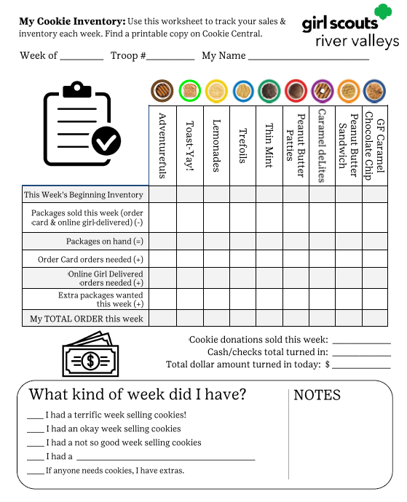
Girl Scout and Troop Experience
New Resource!
My Cookie Inventory Worksheet
    Use to track inventory from cookie sales, donations, & cookie money
    Located on the back of the Family Cookie Guide and on Cookie Central
Notes:
Now, we’ll go over tracking cookie inventory. We’ve developed a resource to help your Girl Scout families keep tabs on their Girl Scouts’ cookies, donations, and cookie money. This is the My Cookie Inventory worksheet – which we recommend families use to help keep track of their on-hand inventory and their inventory needs for order card sales and online sales for local delivery. They can also use the worksheet to track the donations collected and cash/checks they’ve turned into the troop. This worksheet is on the back of the printed Family Guide and a downloadable copy will be available on Cookie Central as well.

Slide 27
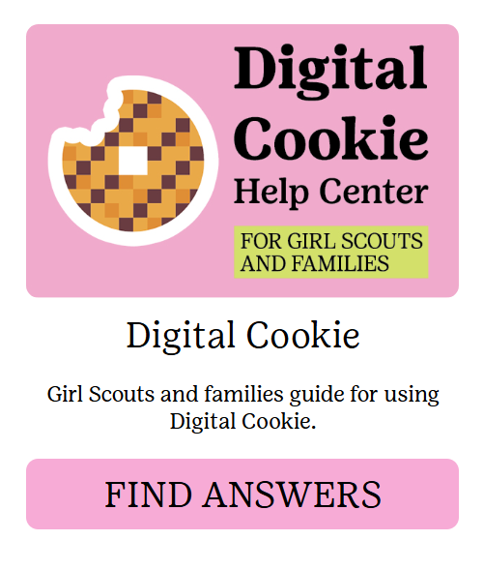

Girl Scout & Family
Digital Cookie Resources
Available on Cookie Central:
Digital Cookie Help Center for Girl Scouts and Families
Tip Sheets & Videos Available
New Help Menu for Desktop Users:
“?” symbol available in top-right corner of Digital Cookie
Notes:
You can direct your Girl Scouts and families to Cookie Central to find resources to help them navigate Digital Cookie, beginning with our Help Center. The Help Center features tip sheets and videos that covers topics such as mobile app payments, sharing their online cookie storefronts, turning on/off varieties, sending emails, approving orders, and more! We even have a comprehensive guide to download and print if needed.
And new this year, Digital Cookie has created a help menu for desktop users, with a mobile version of this coming soon. Within the desktop site, select the question mark symbol on the top-right hand corner. Users can review this menu to find:
-tasks to help them get started in Digital Cookie
-Quick links to: a live chat, tip sheets, video tutorials, and more for Girl scouts, their caregivers, and Troop volunteers
We’re offering Cookie Chats again for 2025, a virtual option for troops to talk directly with our River Valleys team. And just-in-time information coming via The Cookie Press. All of these resources can be found on Cookie Central!
And that’s not all, Your Community Product Leader and our staff are ready to answer your questions-don’t hesitate to reach out when you need help.

Slide 28
Digital Cookie
Troop Basics
Notes:
Now that we have talked about all of the updates to Smart Cookies and Digital Cookie, along with where you can find a multitude of resources, let’s move into reviewing some of the basic functions for Troop Volunteers in Digital Cookie you will use throughout the cookie season. This next section is optional for troop volunteers who have used Digital Cookie before, but if you are new to Digital Cookie (or if you’re in need of a refresher) please continue your Digital Cookie learning journey!

Slide 29
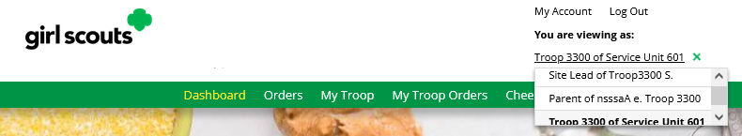
Digital Cookie: Role Selection
Toggle between accounts as a Troop/Caregiver
  Have multiple Girl Scouts? You can toggle between each account.
  Parent role and Troop Site Lead won’t appear until after Girl Scout access date.
Notes:
Once logged into Digital Cookie, volunteers will have the ability to toggle through each of your accounts. If you have multiple GS or troops, you can toggle between them all. The parent role and Troop Site Lead role will not be visible until February 1, when families get access to the site for the first time. This is because the Troop Site functions the same as a Girl Scout’s Digital Cookie account, and Girl Scout access does not start until that time.

Slide 30
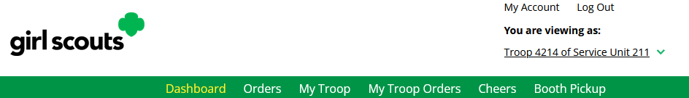
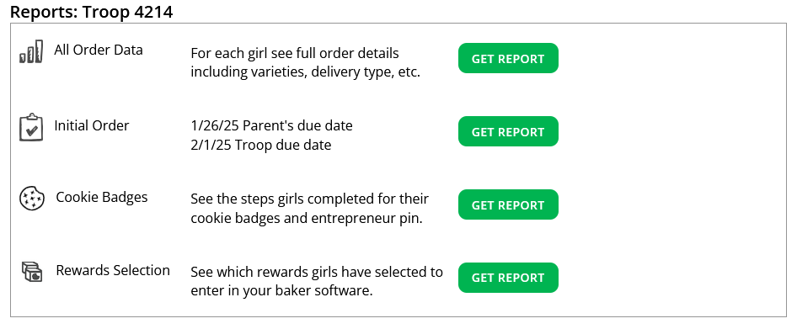
Troop Dashboard
Notes:
Let’s start with the Troop Dashboard. After you have registered your account, you will see six tabs on the troop dashboard. We’ll cover each of these six tabs. The dashboard provides you with a quick glance on online activity . Plus, it’s where you’ll find your troop reports too.
The reports section contains up to four reports to view that can help you manage the Digital Cookie activity for the Girl Scouts in your troop:
All Order Data will show you details on every order placed through Digital Cookie for every GS.
Initial Order (If applicable) River Valleys does not do IO’s for families so this section can be ignored.
Cookie Badges will let you know if girls are completing any of the Cookie Business badges and/or the Family Entrepreneur Pins. Encourage them to complete these with their families to increase their cookie program learnings!
Rewards Selection will not be a functional report. In our council, Girl Scouts do not have the ability to select Rewards in Digital Cookie. Rather, Girl Scouts can use the Rewards tab to view a flyer with all reward options they can use to communicate to their troop leader at the end of the sale.

Slide 31
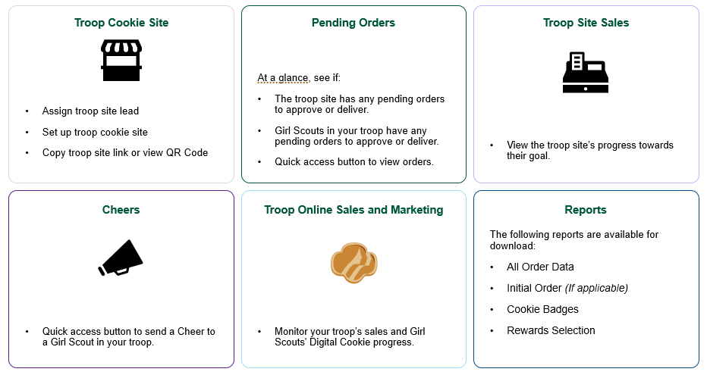
Dashboard
Notes:
Your Digital Cookie Dashboard also features six different sections.
Troop Cookie Site: when you first log in you will see a Get Started button, once the troop site is set up this box will have the troop site links and QR code.
Pending Orders: In this section you will see if the troop site has any pending orders to approve or deliver and if Girl Scouts in your troop have any pending orders to approve or deliver.
Troop Site Sales: This progress bar is for troop site orders only and does not include any Girl Scout orders.
Cheers: here you will find a quick access button that will take you to the Cheers page where you can send a Cheer to a Girl Scout in your troop.
Troop online Sales and marketing: In this section, you can monitor the troop site sales and Girl Scout’s Digital Cookie progress.
Reports: This section contains up to four reports to view that can help you manage the Digital Cookie activity for the Girl Scouts in your troop:
All Order Data will show you details on every order for every girl.
Initial Order (If applicable) will show you the initial paper order card entry by the parents to allow you to compare what is in the baker software if desired.
Cookie Badges will let you know if girls are completing any of the Cookie Business badges and/or the Family Entrepreneur Pins. Encourage them to complete these with their families to increase their cookie program learnings!
Rewards Selection will not be a functional report. River Valleys Girl Scouts will not have the ability to select Rewards in Digital Cookie. Rather, Girl Scouts can use the Rewards tab to view a flyer with all reward options that they can use to communicate to their troop leader at the end of the sale.
For a full review of the troop dashboard, please see the Online Cookie System Guide on Cookie Central for video and tip sheet.

Slide 32
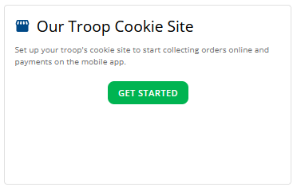
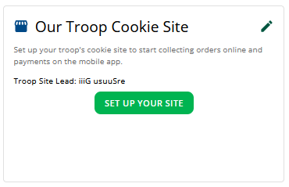
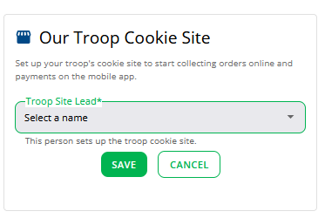
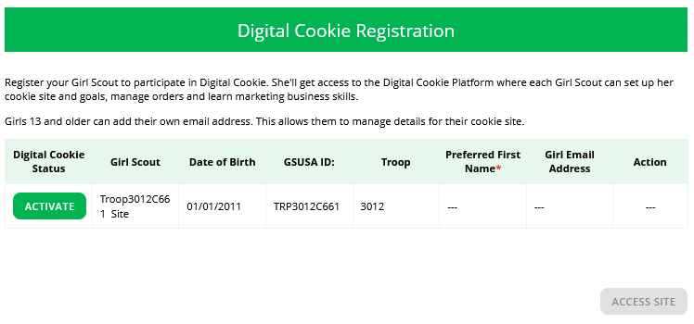
Troop Site Setup
Step 1: Click Get Started
Step 3: Click Set Up Your Site
Step 5: View the Girl Scout & Caregiver slides for instructions to set up the troop site once activated.
Step 2: Select a Troop site lead
Step 4: Activate the Site on February 1
Notes:
The first thing to do after logging in and navigating to the dashboard is to Set Up Your Site. You’ll need to complete this step for your troop’s zip code to appear in the GSUSA Cookie Finder. You can activate your troop site in four steps:
Step 1: click the Get Started button. This button is only on the dashboard prior to the site being activated.
Step 2: Select a Troop Site Lead, if your troop has multiple volunteers, you will select which volunteer will be the “site lead” from the drop down. The Troop site lead will be responsible for working with the Girl Scouts in the troop to set up the troop site and will have access to the troop site’s home page, similar to a Girl Scout’s home page.
Step 3: Once you save the troop site lead, if you choose yourself, you will see the Set Up Your Site button on the dashboard. If you assigned a different volunteer to be the site lead, the next time they log into Digital Cookie they will see the Set Up Your Site button on the troop dashboard.
Step 4: After clicking the Set Up Your Site button, you will be taken to the Registration page where you can Activate the troop site. If you have Girl Scouts in your household, you will see them here too. After Clicking the Activate button, you will be able to click the Access Site button. This will take you to the troop site and you will be ready to set up the site.

Slide 33
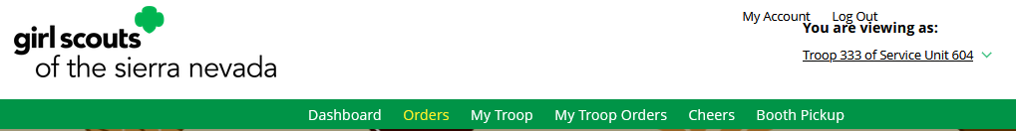
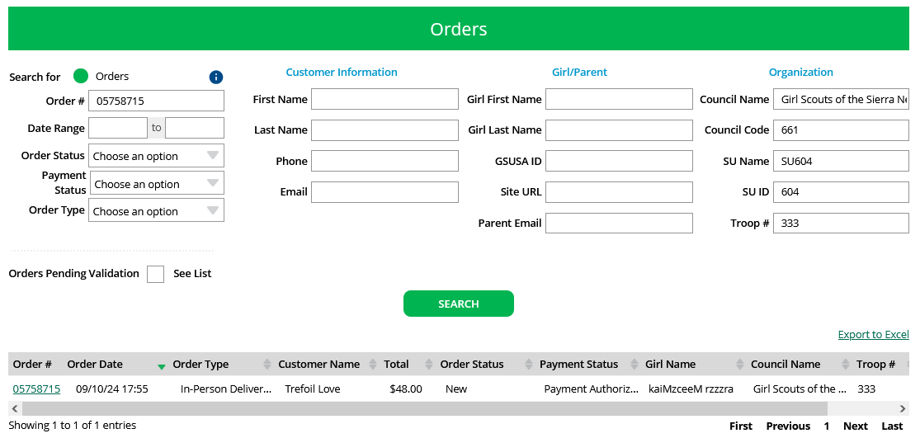
Orders
ABC/LBB
Notes:
Let’s return to our tour of the Troop account tabs.
The “Orders” tab allows you to lookup orders that were placed for all the Girl Scout’s in your troop as well as refund in-person delivery, donation, an cookies-in-hand orders (orders placed on mobile app). Only troop volunteers will have the ability to refund online orders for local delivery, if needed.
Once you are on the Orders page, you can look up the order a few different ways. The recommended lookup options are Customer Order #, Customer Email address, Parent Email Address, Girl Name (first and last), or Customer Name (first and last, min 2 letters). Using more than one can cause the results to not appear properly. You can also narrow down the orders by selecting the Order Status, Payment Status, or Order Type.
After entering the information and clicking Search, the order or orders will appear. From here you can quickly see some of the order details. To see the specific order details, click the order number. This will allow you to view the full details of the order including order type, parent action, and customer information, as well as the variety of cookies, customer payment status, and fulfillment status.

Slide 34
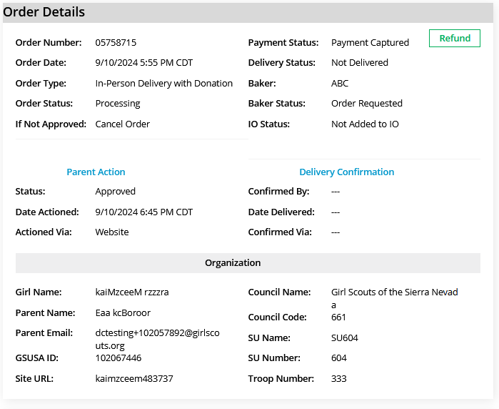
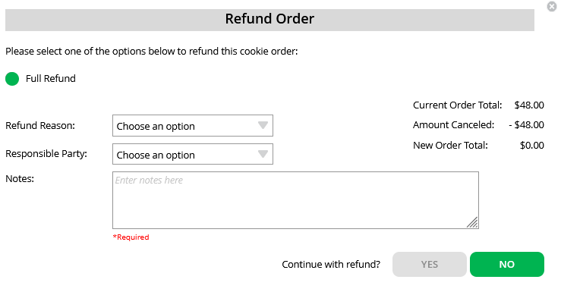
Refunding Orders
Notes:
If you can refund an order, you will see the Refund button next to the Payment Status once you click on the Order #. After clicking Refund, another screen will pop up.
Click the circle for Full Refund. You will select an option for Refund Reason. In general, you will choose “In person delivery issues.”
Then add details in the notes section explaining why you are refunding the order. This will help if someone from the council or Digital Cookie support is looking up the order. Then, continue with refund.

Slide 35
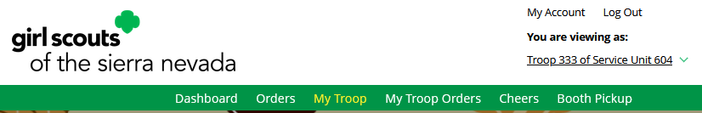
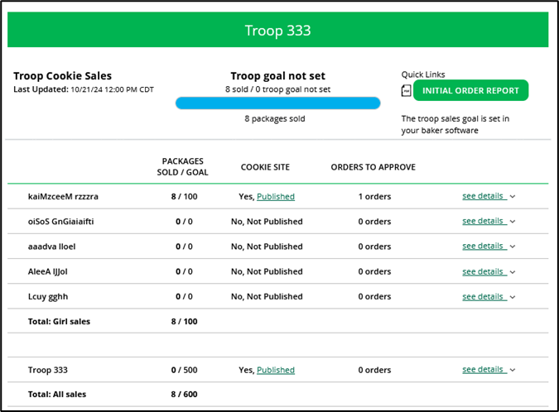
My Troop
3
1
3
2
4
2
5
5
Notes:
“My Troop” tab allows you to see how each girl in the troop is doing in her Digital Cookie Sales and if she has turned off delivery or any varieties. Let’s dig into the 5 highlights you see on the screen.
Troop Goal: This pulls the troop goal set in Smart Cookies and measures the troop’s progress towards that goal. If the goal has not been set yet, it shows total troop’s sales to date.
Cookie Site: If the Girl Scout’s site is published, click on the link to be taken to their customer facing site.
Orders to Approve: This will indicate if the family has any orders that need approving.
See Details/Delivery Change: Clicking “See Details” will bring up details on the girl, her orders, her email marketing to customers and if her parent has turned off delivery or any varieties.
If your troop link has been published you will see what the goal is for the Troop ##### “girl”, you can click the link to go to the troop site and you can see any sales that have come in for the troop link.

Slide 36
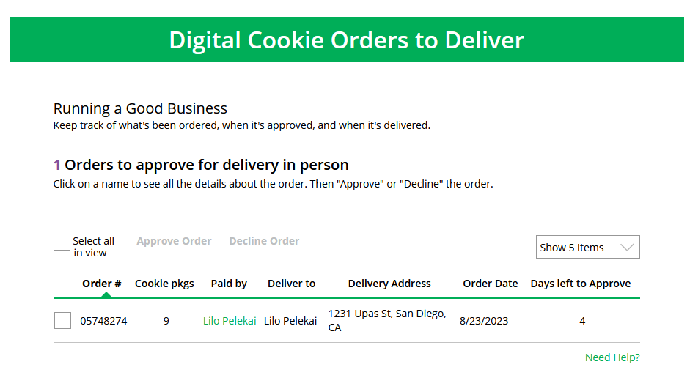
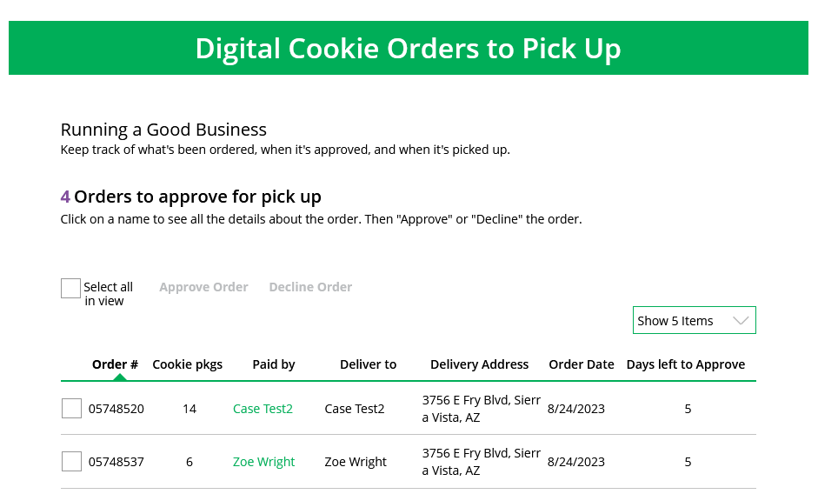
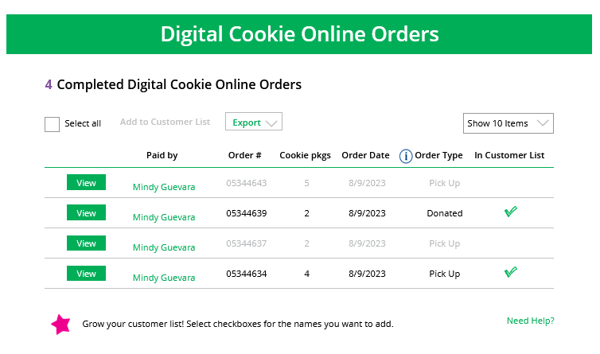
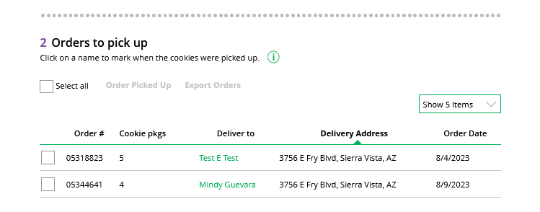
My Troop Orders Tab
Use this tab to see order details for the troop link
Notes:
The My Troop Orders tab works the same as the Girl Scout orders tab, which we will cover soon. If a troop has set up their site for online troop orders for local delivery, from the My Troop Orders Tab they can:
Approve/decline orders for local delivery orders as well as pick up orders that are made through the troop link.
When an order is approved for pickup, it moves down to the Orders to pick up section.
Here you can export a list or find additional details on each order to prepare them for pick up.
Once they are picked up, you can mark them as such in this section as well.
Once the order is complete it moves down to the bottom “completed” section, where you will find shipped and donation only orders placed for your troop, as well as any shipped cookie sales the troop receives from sharing your ship-only link or from the Cookie Finder would also appear in this section.
You’ll also view any canceled/declined orders in this section. They will be greyed out in this section to indicate they were canceled or declined.
If a troop does not set up their troop link for pick up orders or local delivery orders, they will not use this tab in Digital Cookie.

Slide 37
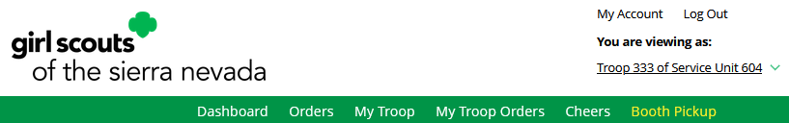
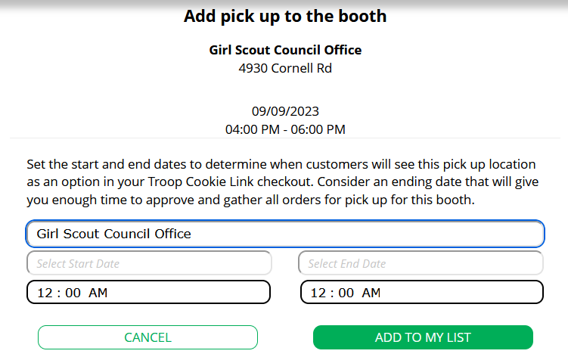
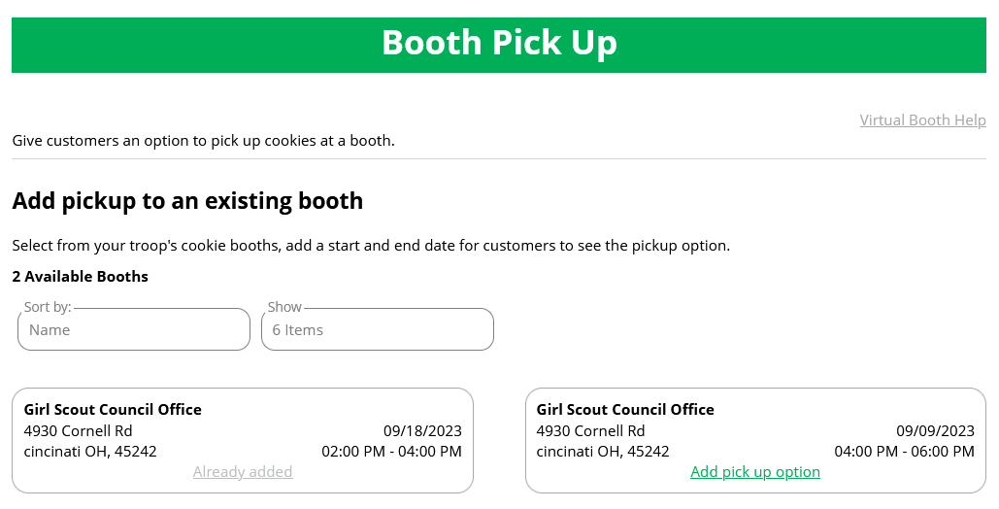
Booth Pickup Tab
Cookie Booths the troop has signed up for in Smart Cookies
Set date and times
Click “Add pick up option”
Edit or delete if necessary
Notes:
Your Booth Pickup page is where you can add the option for customers to place an order online and pick it up at your troop’s upcoming cookie booth. Note that this option is rarely used, but available for troops that have pursued this opportunity in previous years.
To activate that option for your troop customers, there are just a few steps to set up that option using the cookie booths you have signed up for.
Start by selecting an existing cookie booth from your list by clicking on “Add pick up option”
Once you have selected a booth to add a pickup option for customers to, you will need to enter a few details about when the customer will see that pickup location as an option.
NOTE! Consider ending that option 12-24 hours before the booth sale will begin so you have time to review and approve all orders. If you have concerns about inventory for pickup orders, consider ending the option even earlier so you can secure the necessary product for the orders.
If you need to edit or delete your pickup locations, you can view your list of pickup locations and edit or delete them.
Important! If you cancel a booth in the baker’s system, you must delete the booth pick up option from here so customers can no longer select it as a pick-up option.
Check your orders tab for any orders that were scheduled to be picked up and make alternate arrangements or cancel and refund the customers.

Slide 38
Digital Cookie
Girl Scouts/Families Basics
Notes:
Now that we have talked about the basic functions that you, as a Troop Cookie Volunteer will be using, let’s talk about the basic functions for your Girl Scouts and their families.

Slide 39
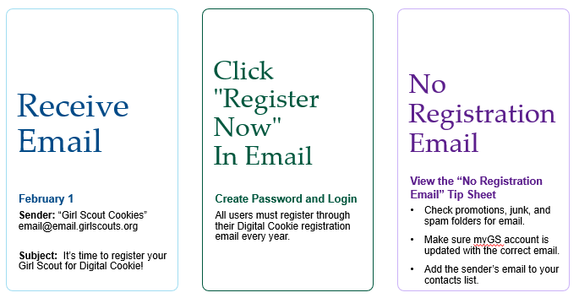
Notes:
Tell families to watch for their registration email* from “Girl Scout Cookies” (email@email.girlscouts.org) with the subject “ It’s time to register your Girl Scout for Digital Cookie!” on February 1. Remind them to search their “Promotions/Clutter/Spam” folders.
The email will be sent to the primary email on file in their myGS account, please ask families to make sure their email address is up to date prior to the access date. If they don’t receive the registration email, direct them to use the tip sheets for additional steps to resend or look up to see what email is on file for their Girl Scout.
Once received, caregivers will open the email and click on the Register Now button to be taken to Digital Cookie to create a password for this year and then log in to Digital Cookie with that password and their email address.

Slide 40
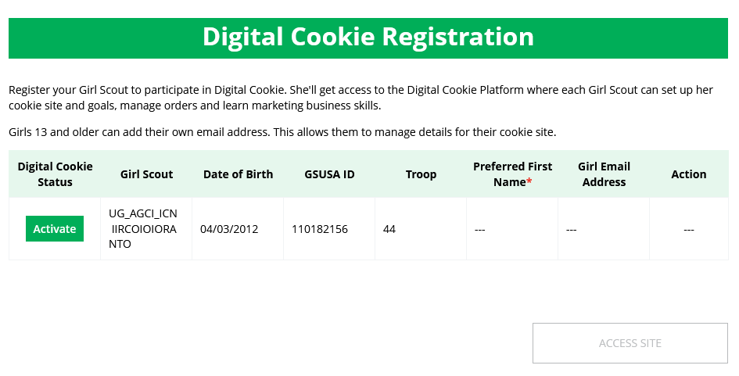
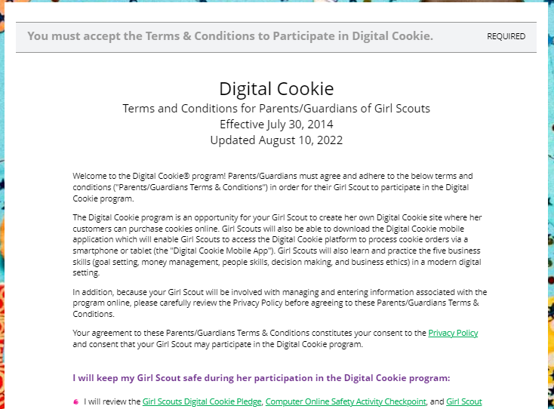
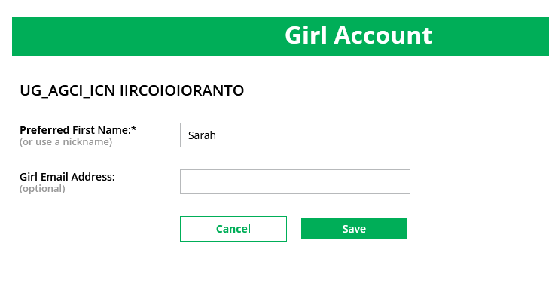
Log in to Digital Cookie
Activate Girl Scout(s)
Watch Safety Video with Girl Scout
After clicking the Activate button you will be able to update your Girl Scout’s preferred name. This name will be on the storefront and in the customer’s emails.
At the end of the video, you will need to click the green continue button.
Approve Terms and Conditions and Safety Pledge
13+ Girl Scouts
You will also have the option to add your Girl Scout’s email if she is 13 or older. Do not add the email address you used to log into Digital Cookie, This is optional, skip this box if you do not want to add an email.
Be sure to read the safety pledge with your Girl Scout and check the box to accept both documents.
Notes:
When they first log in, families will need to watch a safety video, they make should be sure their Girl Scout(s) is available to watch together! You can’t proceed any further until the full video has been viewed. Note: If the adult is both a volunteer and parent, they will only walk through this process once. The parent terms and conditions won’t display until parent access dates start on February 1. There will be a Continue button at the end.
Next, read and accept the Terms and Conditions agreement.
Then the “Girl Scout Safety Pledge” will appear. Be sure to read it to/with the Girl Scout(s) and check the box for “accept” and click “continue.”
Once the parent has accepted the terms and pledge, they will then be taken to a screen to activate their Girl Scout(s) for the Digital Cookie program and update their preferred name if desired.
If the Girl Scout being activated is 13 or older, they have the option to enter an email address. The Girl Scout will then be able to set up the site and monitor Digital Cookie. (Note, the email address for a Girl Scout 13+ must be unique and not in use in Digital Cookie).
Girl Scouts under 13 will log in, in partnership with their caregiver and do not need a separate email address.
After activating the Girl Scouts (if you have multiple), click the “Access Site” button to be taken to the first Girl Scout’s home page. Once registered, watch for a registration confirmation email and be sure to save this email where it can be found during cookie season!

Slide 41

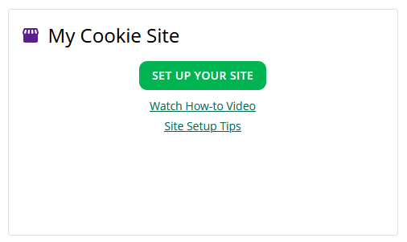
Have multiple Girl Scouts? Easily switch between each site here.
Setup Your Site
Four sections to set up the site
Goal Setting: Set My Sales Target
My Cookie Story
Photo/Video Upload
Preview and Publish Your Site
Notes:
The next step is to set up the site.
They simply click on Site Set up or scroll down to click on the “Set up your Digital Cookie site…” link in the “My Cookie Site” section, or the “Site Setup” at the top of the page. If a caregiver has multiple Girl Scouts, they can switch their roles on this page. Volunteers can toggle between their caregiver and volunteer roles here too.
There are four sections on the site set up page. The next few slides will cover them in more detail.
1. Goal Setting
2. “My Cookie Story
3. Photo/Video Upload
4. The 4th section is to Preview and Publish Your Site

Slide 42
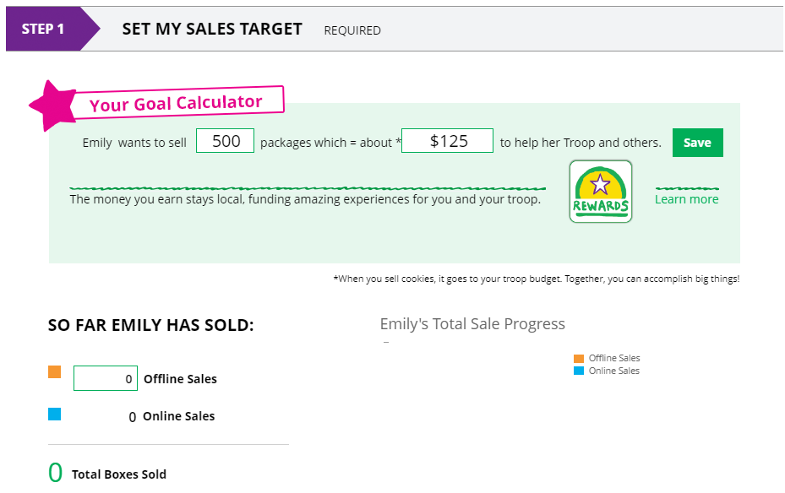
1. Setting your Sales Goal
2
1
3
4
Notes:
Goal Setting: “Set My Sales Target”: which is a high level overview for the family with a section to track progress to the Girl Scouts goal and progress towards the troop goal.

Slide 43
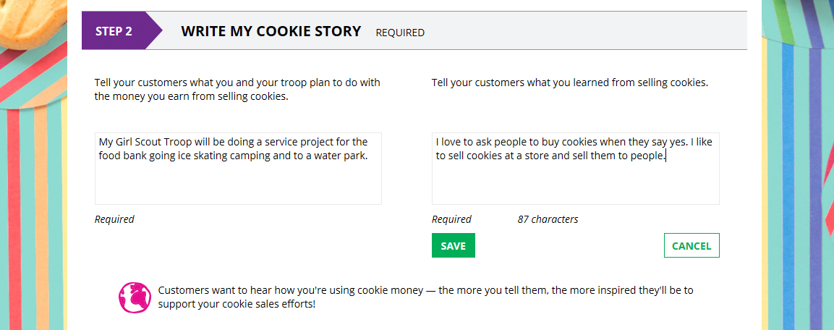
2. Write My Cookie Story
1
2
3
Notes:
“My Cookie Story”: Girl Scouts tell their customers about their troop goal and why it’s important. Girl Scouts share what they’ve learned from the cookie program. After they save their story they can make edits to it at any time.

Slide 44
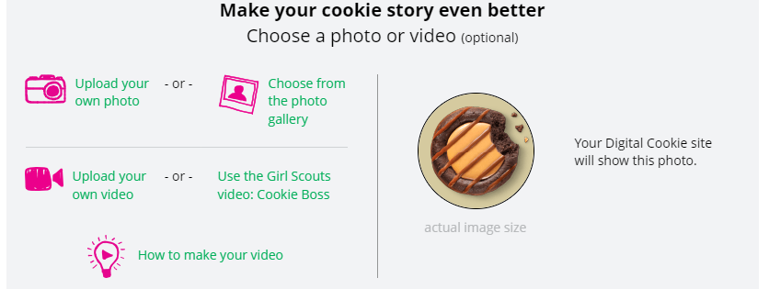
3. Uploading a Photo/Video
Girl Scouts who uploaded a photo or video of themselves sold more than double the boxes on average than those who did not.
Notes:
Photo/Video Upload: Girl Scouts can choose to upload a photo or use a picture from the gallery. Or Girl Scouts can upload a video or use the pre-recorded video. You’ll even find tips on how to make a great video on this set up page.

Slide 45
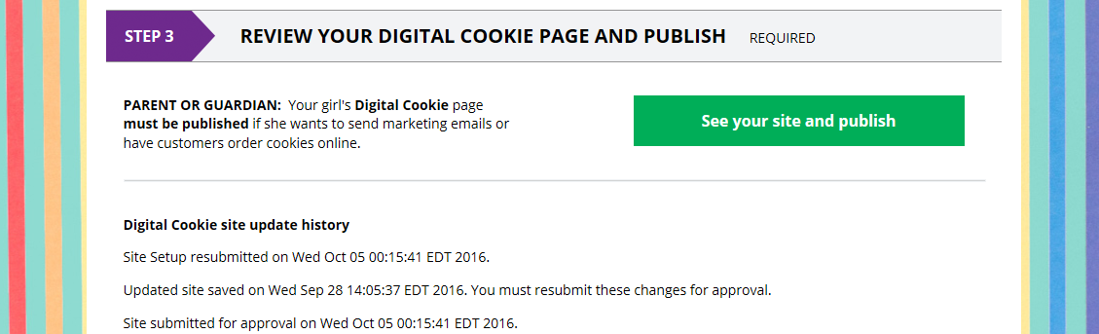
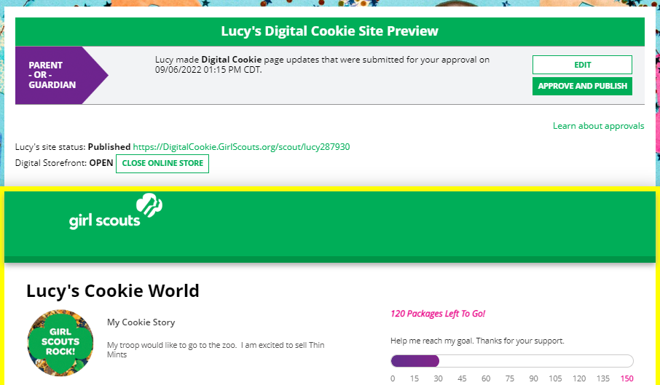
4. Approving and Publishing
If your button only says “see your site” you may be missing required fields or didn’t make changes.
Click to edit
Click to review and publish
Notes:
The next step is to Preview and Publish Your Site: Once the Girl Scout has entered all the site details, they will click the See your Site and Publish button. They will see what the customer will see.
There are a few things you should check prior to publishing the site:
Is the spelling and grammar correct and does it tell a story?
Make sure the photo or video are displaying correctly.
Are the goals accurate?
If you need to change anything, click Edit and make changes
If it looks good, approve and publish the site.
Girl Scout’s 13+ will have a button that says, “see your site and submit for approval”. They can see the preview and edit and their caregiver will be sent an email to approve the site.

Slide 46
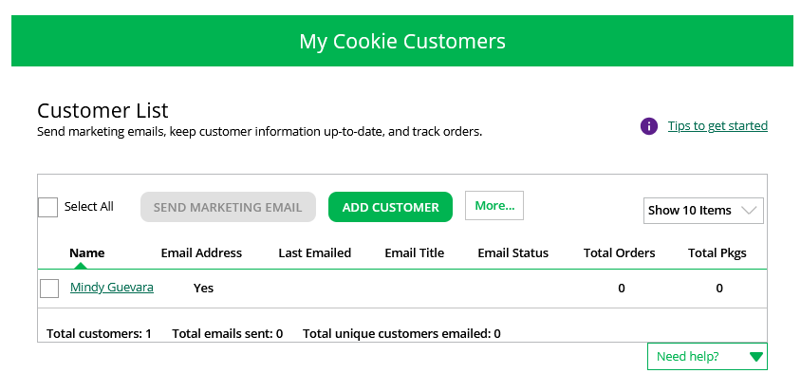
Invite Customers
Add or import customers
Notes:
After the site is set up and published, Girl Scouts can begin inviting customers!
On the Customers tab:
Girl Scouts can add a customer individually by clicking the Add Customer button or import their customers under the More button. At the end of the cookie season, don’t forget to export the customer list to save it for the next season.

Slide 47
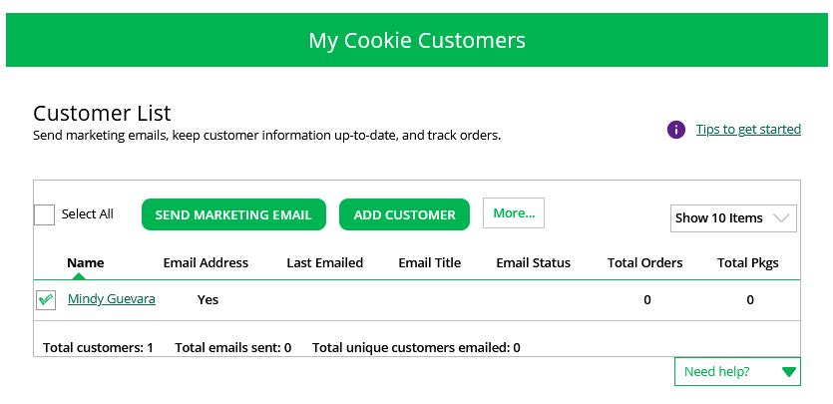
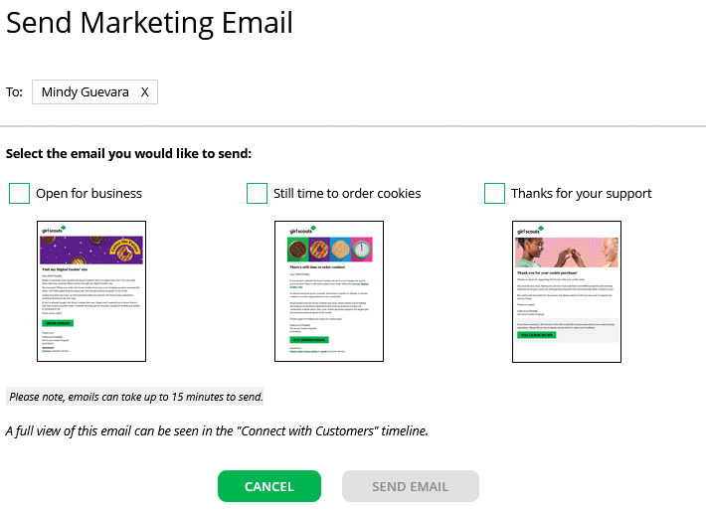
Then select which marketing email to send.
To Send email, first check box, then click Send Marketing Email Button.
Notes:
After the customer is added, Girl Scouts can send marketing emails. To send a marketing email first check the box next to the customer’s name or if this is the first time check Select All. Then the Send Marketing Email button will be available.. After clicking Send Marketing Email, a pop-up box will appear with three different emails to choose from. Open for Business, Still Time or Order Cookies, and Thanks for Your Support. If you do not see Open For Business, that is because River Valleys has a shipping promotion in progress and the shipping promotion email has taken its place. For those who do not want to offer the shipping promotion email, use the Still time to order cookies email instead.
Girl Scouts can also view and edit their customer’s information from the customer page by clicking on the customer's name. From here they can delete, edit, or add another customer. They can also see if the customer placed an order. Now that they’ve added their Customers to the Customer List, it’s time to set up their site for local delivery. This will allow customers to order directly from their personalized storefront and see real-time information on what cookies are available. Please watch the following video to learn more about this option.

Slide 48
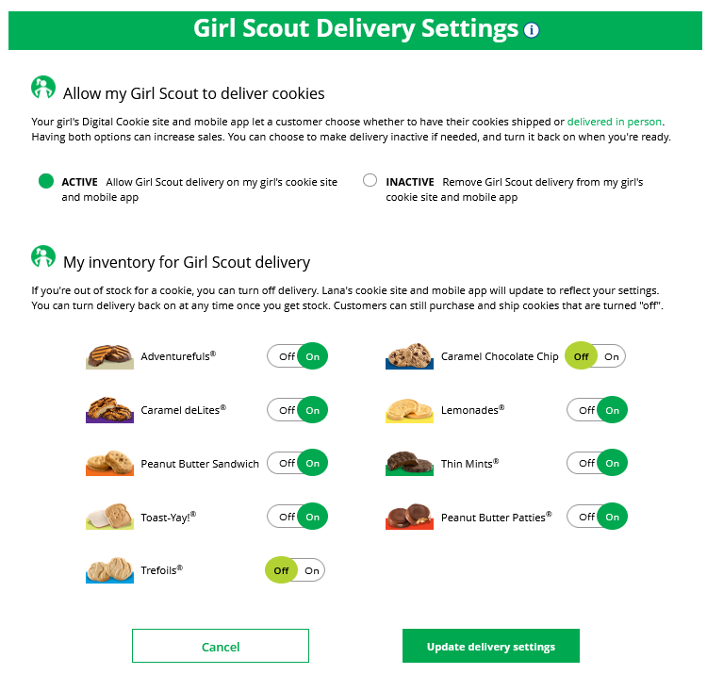

My Cookies Tab-Delivery Settings
Notes:
Script:
The Delivery Settings function gives you the opportunity to turn off Girl Scout delivery and off varieties of cookies. This might be useful if you run out of a cookie variety and can’t get any more to fill customer orders or you are entirely out of cookies for delivering to customers or otherwise are unable to deliver cookies to customers.
If you are worried about your inventory, always check with your troop cookie volunteer first to see if you can get more cookies before turning off a variety. Turning it off means a customer doesn’t have the option to purchase it for delivery so you don’t have to decline their order and disappoint them if they can’t get the variety they ordered.
When you know you need to turn off delivery or a variety(ies), go to the bottom of your “My Cookies” tab and find the Girl Scout Delivery Settings section.
When you select “inactive” to turn off the Girl Scout delivery option for your customer, you will get a warning message. If you want to turn delivery off, click “Update delivery settings”. Once you have turned it to inactive, the varieties section will be removed and is superseded by a message. You can turn the site back on at anytime during your council sale dates.
If you wish to offer delivery but are out of a cookie variety and can’t get more inventory, you can turn off just that variety of cookie for delivery and customers can only purchase those for shipping and not delivery. To do that, simply click the “off” button then click the Update delivery settings button, and it will remove that variety from the Girl Scout delivery option. If you are able to offer that to customers again, return to this section and click the “on” slider to turn that variety back on.

Slide 49
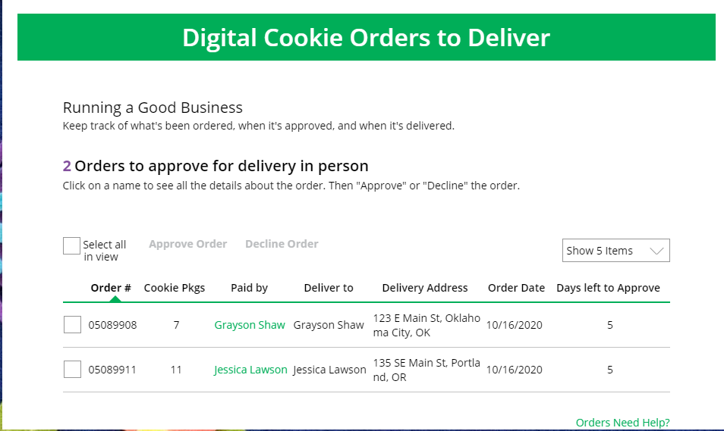
Orders
Click on the “Paid by” name to review customer and order details
When determining whether to approve or decline the order, consider:
Is the customer a known and trusted individual?
Are you willing and able to get the cookies to the customer’s location before the end of the sale.
AND
Do you have or will you have the inventory available?
If so, “Approve Order.”
Notes:
Script:
The top of the orders page is a list of any In-person delivery orders that need to be approved.
In this section you will see a brief overview of the order.
Orders must be approved or declined with in 5 days, or the order will be automatically declined and revert to the customer’s second option of cancel or donate. The order cannot be changed, and the customer will have to place another order.
::Read slide on determining whether to approve order::
If you are unable or unwilling to fulfill the customer’s order, click “Decline Order” and the order will default to whatever second option the customer has selected: “Cancel” or “Donate”.
If an order has not been approved by midnight, you will receive an email from email@email.girlscouts.org with the subject “Action required: you have an in-person delivery request!”.

Slide 50
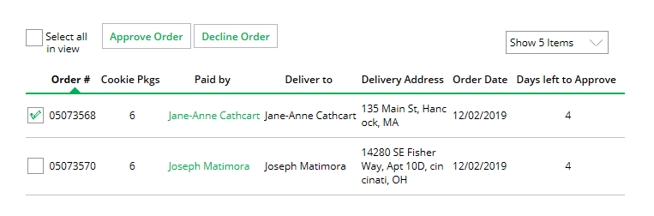
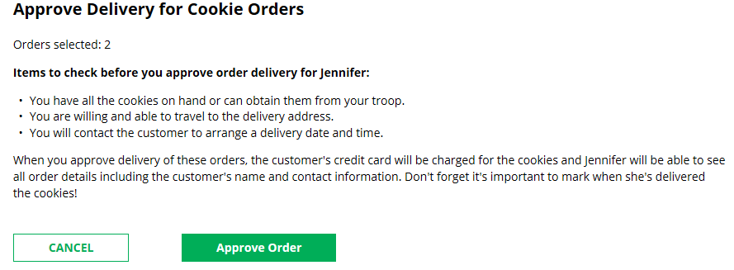
Orders
Approving/Declining Orders in Bulk
Check box
Once you approve or decline you can’t change the action and an email is deployed to the customer.
Notes:
Script:
There are multiple ways to approve and decline orders for delivery. The first way is to approve orders in bulk. You can do that by checking the boxes in front of the orders you want to approve or decline and then click “Approve Order” or “Decline Order”
A pop-up message will appear asking you to confirm the action you have selected.

Slide 51
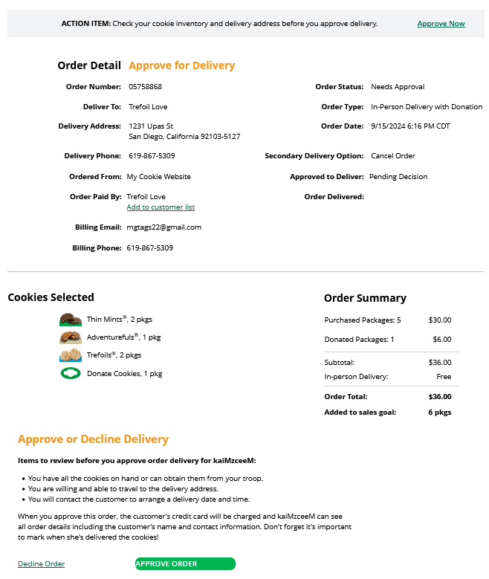

Orders
Once approved: customers receive an email to expect their cookies within two weeks of when you have them.
Approving/Declining Orders Individually
Notes:
Script:
The second way to approve orders is individually:
Click on the customer's name to bring up the order details and click “Decline Order” or “Approve Order” at the bottom.
If you decline the order, you will get a pop-up message confirming you want to decline the order and understand if the order is being cancelled or donated.

Slide 52

Orders
Orders to Deliver
Orders must be marked as delivered to update cookie inventory correctly.
Select all
OR
Select a customer
Notes:
Script:
After approving an order, the order will pop down to the next section “Orders to Deliver”. Once the order has been delivered, log back into Digital Cookie and mark those orders delivered.
There are two ways to indicate you have delivered your order:
Check the “Select All” box to select all of the orders on the page; they will all be marked “Order Delivered”.
Check the box in front of any orders you have delivered, and then click “Order Delivered.”
When they are marked as delivered, they will move down into the third section on the page as a completed order.

Slide 53

Completed Orders
Orders
Customers not added to the customers list will not roll over to the following year.
.
Notes:
Script:
In the completed orders section, Girl Scouts can see all orders including shipped and donated orders.
If the customer is not in her Digital Cookie contact list, your Girl Scout can check the box in front of the customer’s name and click “Add to Customers tab.” Then, the customer will be in her records for sending thank-you emails this year and marketing emails next year for repeat business.

Slide 54

My Rewards
View a copy of the Rewards Flyer and connect with your Troop Volunteer at the end of the sale to make selections. Reward selections are unavailable in Digital Cookie.
Notes:
Girl Scouts can see the reward options that they can earn for selling cookie packages by clicking on the link to view the Reward Flyer at the “View ALL Council Rewards” link.
Girl Scouts need to connect with the Troop Cookie Manager at the end of the sale to make their reward selections. Girl Scout will not be able to make reward selections in Digital Cookie.

Slide 55

My Cookies
While not required, you can take the extra steps in the My Cookies tab to track inventory.
Families can also use their own tracking system and/or receipts provided by the troop for their physical inventory totals.
Notes:
The next tab on the Girl Scout’s Digital Cookie page is the My Cookies tab. While not required, Girls and Troops can take the extras steps in this tab to track their cookie inventory. Families can also use their own tracking system and/or their receipts provided by the troop for their physical inventory totals. View the Cookie Program Family Guide, included in the Troop materials, for an inventory tracking worksheet or find it on Cookie Central.

Slide 56

My Cookies Inventory: Offline Sales
The total number of packages that have been allocated to your Girl Scout from the troop cookie volunteer.
Offline sales can be updated by the Girl Scout/caregiver when the Girl Scout delivers cookies not ordered/paid for through Digital Cookie.
1
2
Notes:
The top part of the My Cookies page shows the total number of packages that have been allocated to a Girl Scout from the troop cookie volunteer. It could include booth sales or troop sales. It is not the same as the number of cookies the Girl Scout is responsible for.
The inventory section gives a quick view of how many cookies are undelivered and how many are needed to fill in-person orders.
“My Offline Sales” This is something that can be updated by the Girl Scout/her caregiver when they deliver cookies and receive a cash or check payment for them. If they are not entered in this section, the cookies will not be removed from her inventory and this section will not be correct.
To enter offline sales, click the down arrow by the number of packages on the left side and open a screen to enter those sales. When those are entered, click “Save Updates”
Once Save Updates is clicked the Girl Scout will be asked to confirm they want to update the inventory.

Slide 57

My Cookies: Inventory by Variety
Current Inventory
Pending Delivery/To Approve
Inventory Needed
1
2
3
Notes:
There are three other sections that calculate inventory.
The first is “Current Inventory”. Clicking the arrow next to the total number of packages will show this information by variety.
Click the arrow next to any of the cookie varieties to see more detail on how this number was calculated.
The “Received” number comes from the information the Troop Cookie Volunteer has of how many cookies the Girl Scout has received and signed for.
The “Delivered” section will reflect the Offline Sales the Girl Scout have entered, as well as any sales the Girl Scout made on the Mobile app using the “Give Cookies to Customer Now” feature, plus any girl delivery orders that have been delivered and marked as delivered to the customer on the orders tab.
The next section “Pending Delivery/To Approve” will show how many cookies are needed to fill girl delivery orders that have been approved or have yet to be approved. Expanding each variety will show how many orders are approved or need to be approved along with how much inventory is needed for each of those categories.
The final inventory section is “Inventory Needed”. This will show if any packages of cookies are needed to fill orders. Expanding any of the sections with a number will show how many packages +are needed and why. If there is a number for a variety in this column, Girl Scouts will check to make sure they can get the cookies needed before approving a customers’ order.

Slide 58

My Cookies: Financials
See how much money is owed for cookies and how it’s calculated. If this information doesn’t look correct, the troop volunteer should verify they have completed actions in Smart Cookies to track Girl Scouts payments.
Notes:
The Financials section can help Girl Scouts understand the amount due for the cookie sale and how the troop is calculating the amount. If the information in this section (like Total Balance Due) seems off, this may be because the troop volunteer has not added a Girl Scout payment in Smart Cookies.
Using the “at a glance” view is a great way to see the overall amounts paid and due. If more detail is needed, expand any of the sections to find out more.
There are four sections that can be expanded to get details.
Initial Cookies (Order Card)
This section does apply because Girl Scouts River Valleys does not do parent/caregiver initial order.
Additional Cookies Received
The categories are the same as the Initial Cookies but reflect packages transferred to the Girl Scout from the troop. Girl Scouts should reach out to their TCM For any questions about this or if this figure does not reflect the packages picked up.
Payments
Online Paid: This reflects any online payments received for In-Person Delivery or Cookies in Hand orders
Offline Paid: This amount is any payments for cookies received offline, generally cash or check, that have been given to the troop volunteer and have been entered into Smart Cookies.
If this does not match their records, Girl Scouts should contact the troop cookie volunteer to help understand the differences.
Total Balance Due
Total Money Owed: The amount owed for the cookies cookies received. Note,
Total Money Paid: The total from the “Payments” section.
Total Balance Due: The difference between the amount owed and the amount paid.

Slide 59

To recap:
Register and set up your Girl Scout and/or Troop site
Import Cookie Customers
Girl Scouts can opt in/opt out for in person delivery and turn on/off cookie varieties
Orders for local delivery must be approved within 5 business days in the Digital Cookie site
The My Cookies tab is not required
Notes:
To recap this section:
-Girl Scouts will register and set up their Girl Scout site
-They can import Cookie Customers and send marketing emails
-Girl Scouts can opt in/opt out for in person delivery and turn on/off cookie varieties
-Orders for local delivery must be approved within 5 business days in the Digital Cookie site
-The My Cookies tab is not required, but is an optional tab to help with tracking cookie inventory

Slide 60

Digital Cookie Mobile App
Your digital cash register for in-person & booth sales:
Set up Digital Cookie site with a browser
Download new version of app
Login with your Digital Cookie email & password
Available from the App Store & Google Play Store. View the Mobile App Tip Sheet coming to Cookie Central.
Notes:
Next, we’ll talk about the Digital Cookie Mobile App.
In order to take credit card payments for in-person sales or booth sales, both Girl Scouts & volunteers will use the Digital Cookie mobile app, which is available from the App Store & Google Play store. Think of the app as your digital cash register to ring up these sales. Before downloading the app, users will first need to set up their Digital Cookie site in a web browser. If this step is missed, you will get an error. The login for the app will be the same email address & password you use for Digital Cookie. Families will be able to accept credit card/Venmo/PayPal payments at booths using their Girl Scout’s account at a booth. Both Apple & Android Users can scan a credit card with their mobile device’s camera to speed up the credit card process. We’ll provide a tip sheet with all the details on how to use the mobile app for families and troops, which will be included in our Digital Cookie Help Center on Cookie Central.

Slide 61




Digital Cookie Mobile App
Visit My Site
Customers can scan the QR code to visit the Troop’s Cookie Site.
Email My Site
Select Troop Role
Girl Scout’s can send a marketing email to a customer.
Notes:
When you first log into Digital Cookie, select your troop role to see the main screen. From here you can place a new cookie order, share the site with customers, or view all orders.
The “Visit My Site” button will take the Girl Scout to a QR code, the Girl Scout can then turn the phone around allow the customer to scan the QR code to make a purchase from the Troop’s Cookie Site.
The “Email My Site” button is used to send a marketing email to customers who can then purchase from the Troop’s Cookie Site at a later time.
To take an order using the mobile app, Girl Scouts will click the “New Cookie Order” button.

Slide 62

Digital Cookie Mobile App
Step 1: Select Cookie Varieties
Notes:
To begin placing a new cookie order, first the Girl Scout will enter the varieties the customer would like to purchase by using the plus and minus signs next to each cookie variety. Then select Checkout.

Slide 63





New Cookie Order
Step 2: Select how the customer would like to receive their cookies.
Notes:
Next the Girl Scout will determine how the customer will receive their cookies. If using the troop app, like at a cookie booth, the most likely way is “Give cookies to customer’s now”. The other options are available but are less likely to be used through the mobile app. Once the “Give cookies to customer now” option is selected, the Girl Scout can now choose if they are at a booth or not. If at a booth is selected, the Girl Scout will be able to select which booth the troop is at. Then they will click continue.

Slide 64


New Cookie Order
Only available for Cookies
In-hand orders
Step 3: Select how the customer would like to pay
Demo
Demo
Notes:
Next the Girl Scout will ask the customer how they would like to pay for their order. The customer can choose Credit Card, PayPal or Venmo. The PayPal/Venmo options are only available through the mobile app when the Give Cookies to Customer Now option has been selected. If the customer chose PayPal or Venmo and the Girl Scout has selected that option and clicked Place Order , a QR Code will appear n the GS mobile device. Next, the Girl Scout can turn the phone around and the customer can scan the QR code with their phone to pay with their PayPal/Venmo account.

Slide 65



Contact details are now optional. Girl Scouts should still ask if the customer would like an email confirmation.
New Cookie Order
Step 3: Select how the customer would like to pay
Use the Scan Card feature instead of typing all the numbers.
Tip: Have good lighting and double-check the numbers before placing the order.
Notes:
If the customer chose to pay by Credit Card, the Girl Scout will scroll down on the phone to enter the payment details. Once the payment details have been entered the Girl Scout can ask the customer if they would like to receive an email confirmation. While the customer details are optional now it is always good to ask and handy to have in case of any issues with the order.
If the customer chooses to pay with Venmo/Paypal, a QR code will pop up on the screen for the Girl Scout to show the customer. The customer will scan the QR code with their own mobile device and complete payment. Once payment is complete, the Girl Scouts mobile device will reflect this with a Thank You page.

Slide 66



All Orders
All users have access to approve orders through the mobile app
Notes:
From the home screen, users can view all the orders placed through the troop’s cookie site as well as through the mobile app by scrolling down to the all-orders section. To view the orders in a specific category, click on the green arrow to the right to bring up all the orders. Then click on the order you want to view. If the order is an in-person deliver order users can approve or decline the order from the app. Leaders should have a conversation with parents regarding the process of approving orders placed on the troop site, since all users will be able to approve these orders.

Slide 67


Digital Cookie Help Center
Your go-to place if you need support!
Notes:
We are almost to the end of our Digital Cookie information! We know this is a lot of information to absorb, but rest assured, there is plenty of help available. The first resource we want to highlight is the help functions built into the site. If you or a family needs help with logging in,
Click “Need help to log in” if…:
you didn’t receive your registration email and you want to check which email address is on file.
Forgot your password
Then, you can also click Help at the bottom of the page to go to the Help Center.
On each page in Digital Cookie, you’ll see a tips icon or a need help drop-down arrow directing you or the family to the help resources that are available, so they can self-serve if they need additional support or find themselves stuck.

Slide 68


Digital Cookie Help Center
Select which role and category you need support on.
Inside, each category will have detailed instructions, links to tip sheets, or even video tutorials to help you.
Notes:
The help center in Digital Cookie has resources for families & Girl Scouts, Volunteers, and customers too! Just select the role you need support on and then select the category to reveal all the options available.
Inside each category you’ll find detailed instructions, links to tip sheets, or video tutorials to help the user, whether it’s the family, troop, or a cookie customer.

Slide 69

Digital Cookie Help Center
After looking, still can’t find what you need? Contact customer support.
Click the topic you need help with and complete the form for more assistance.
Or click the Live Chat button to chat with a Digital Cookie support agent during business hours.
Notes:
Still need help? Click on the Contact customer support link at the bottom of the Help center page.
Click the topic you need help with and complete the form for more assistance. This process is very similar to the customer support section you’ll find when online shopping at major retailers.
Want to talk to a live agent? Click on the Live Chat button during business hours to chat with a Digital Cookie customer support agent.

Slide 70
Key Takeaways
Volunteers will use Smart Cookies to:
Manage Troop Inventory, Sales, & Order Rewards
Girl Scouts will use Digital Cookie to:
Engage in online sales: marketing emails, unique sales links
Troops use Digital Cookie to set up their troop site to:
Take booth payments with the mobile app
Cookie Finder
Monitor online sales & refund Orders (if needed)
Option for booth pre-paid pick up & delivery sales
Both Troops & Girl Scouts will use the Mobile app to:
Process Credit Card/Venmo/PayPal payments for booth sales. Girl Scouts will also use it for any cookies on hand sales.
Familiarize yourself AND families with the Smart Cookies & Digital Cookie learning resources
Notes:
Volunteers use Smart Cookies to manage the troop's inventory, sales, and order rewards.
Girl Scouts use DC to engage in online sales, such as sending marketing emails and sharing their unique sales links for online orders for in-person delivery and/or shipped cookie sales.
Troops use DC to set up their troop site to: take booth payments with the mobile app, be included in the Cookie Finder for shipped sales, monitor online sales, refund orders if needed, and the option for booth pre-paid pick up & delivery sales.
Both Troops & GS use the Mobile app to process CC/V/PP payments for booth sales. GS will also use it for any cookies on hand sales.
Be sure to familiarize yourself AND families with the Smart Cookies & Digital Cookie learning resources

Slide 71

Thank You!
We look forward to supporting you during the 2025 Cookie Program!
Notes:
And that concludes the final portion of our Troop Cookie Manager online trainings for 2025. Thank you for taking on this important role. Your hard work and dedication is what makes the Cookie Program possible, and we couldn’t do it without you! Our team at River Valleys are ready to support you, please don’t hesitate to reach out if you have questions or concerns.

